Slide 1
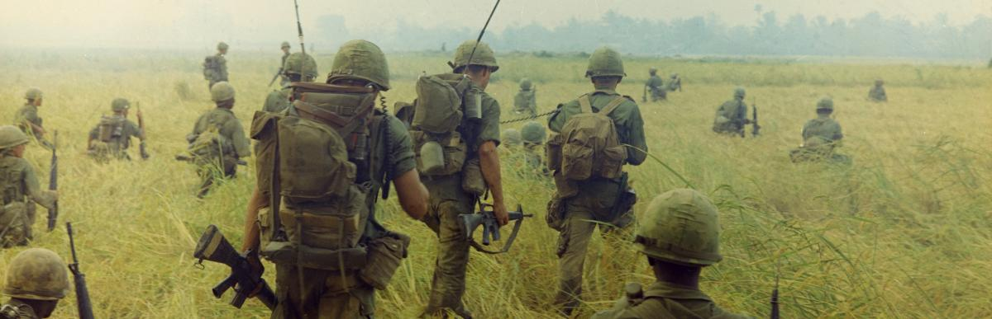
How could the day of your birth affect your life?
An analysis of Vietnam's Draft Lottery (1969)

Slide 2
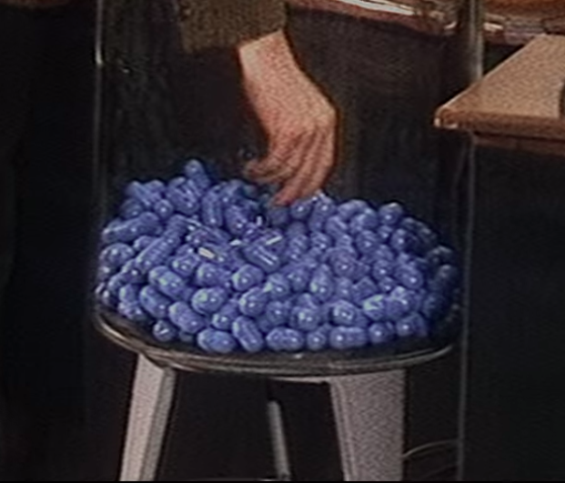
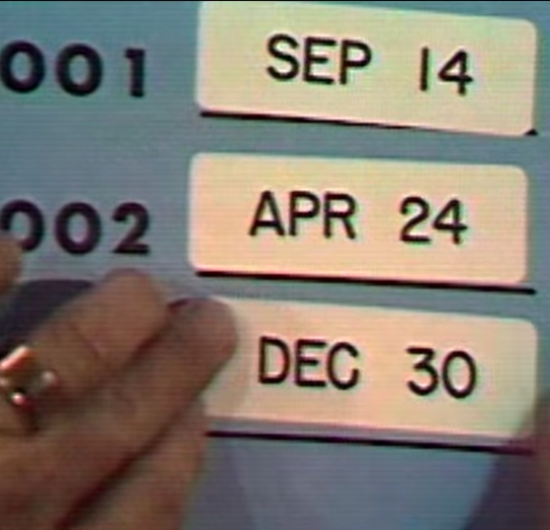
- Context : Vietnam's War
- Who was recluted? Lottery system (1969-1972)
- Project objetive: Was the draft fair?

Slide 3
PROJECT STEPS
- Data collection, cleaning and wrangling
- Exploratory Data Analysis (EDA)
- Linear Regression
- Montecarlo simulation

Slide 4






TOOLS AND LIBRARIES

Slide 5
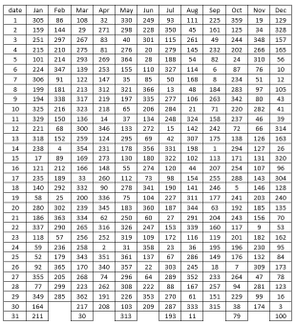
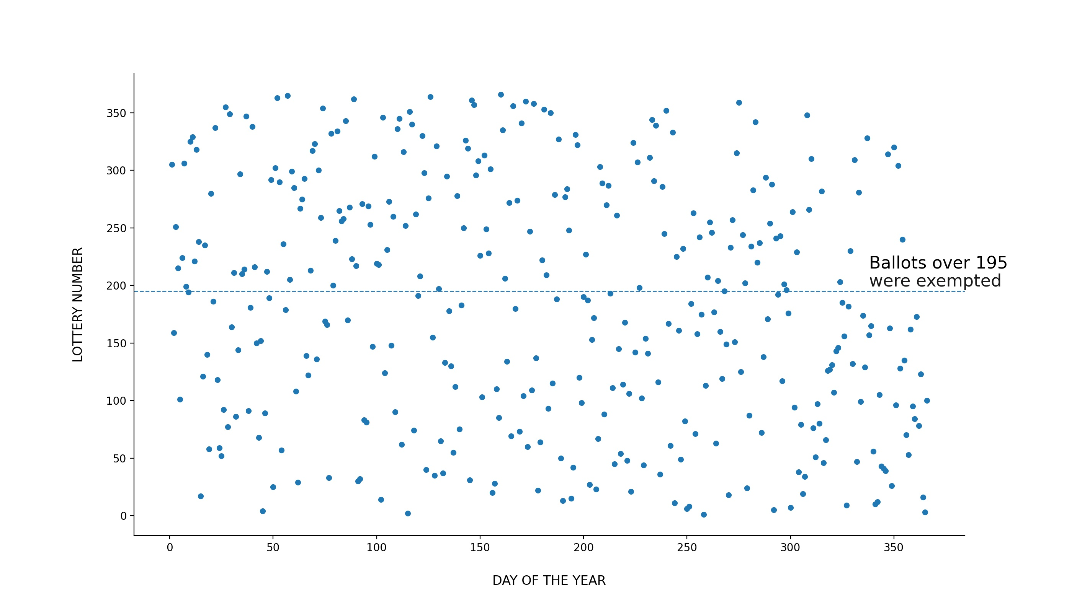
Was the distribution random... or did it follow a trend?

Slide 6
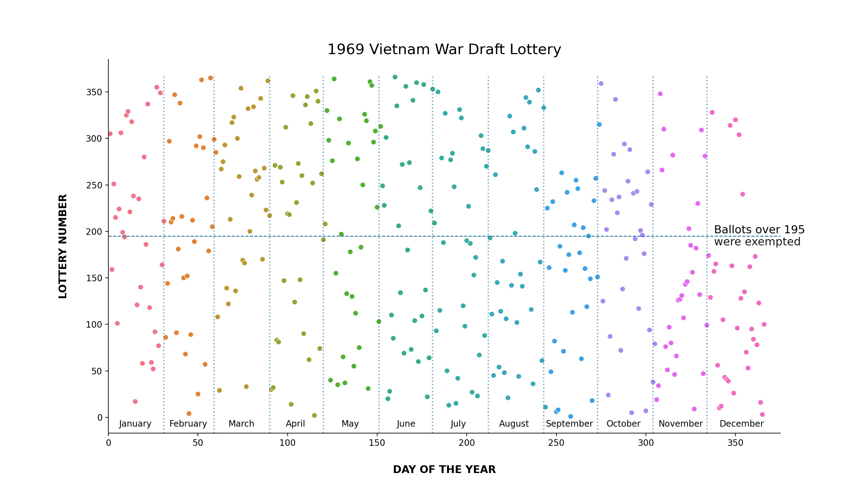

Slide 7
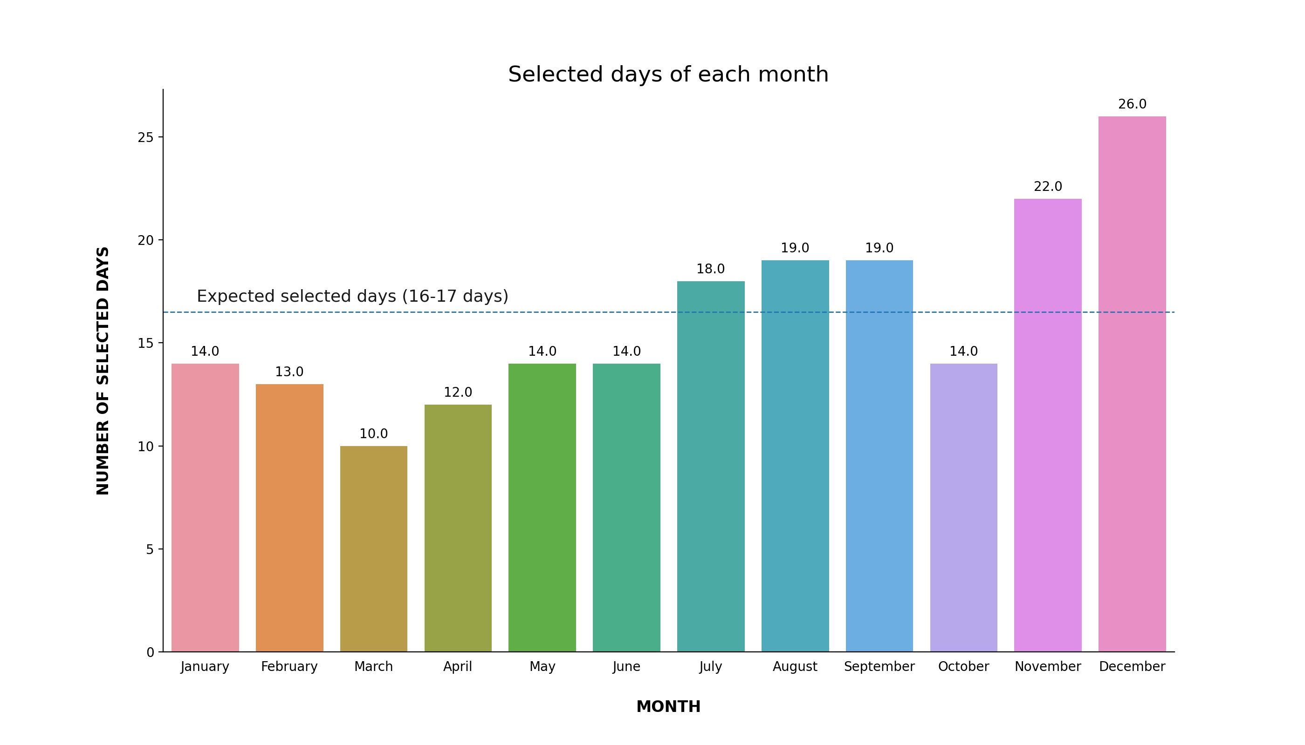
In December, 26 days out of 31 were selected!

Slide 8
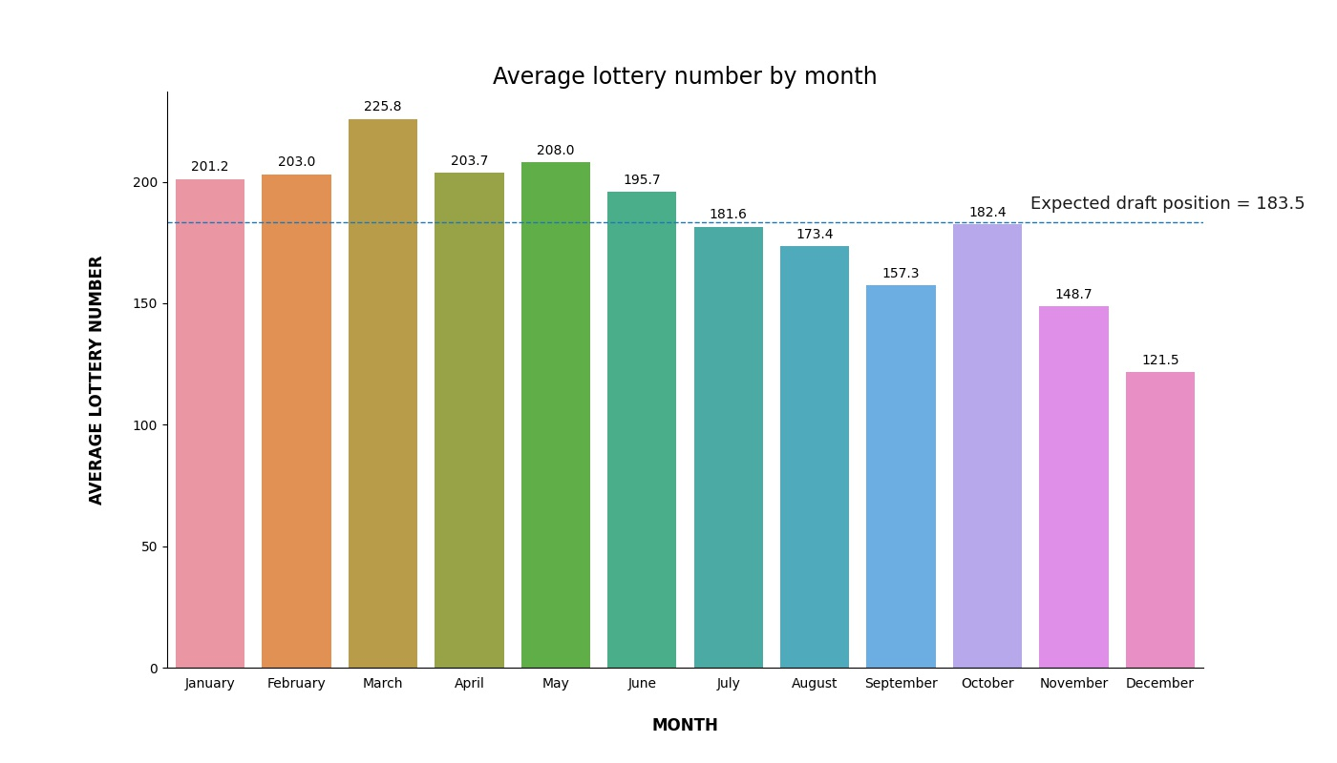

Slide 9
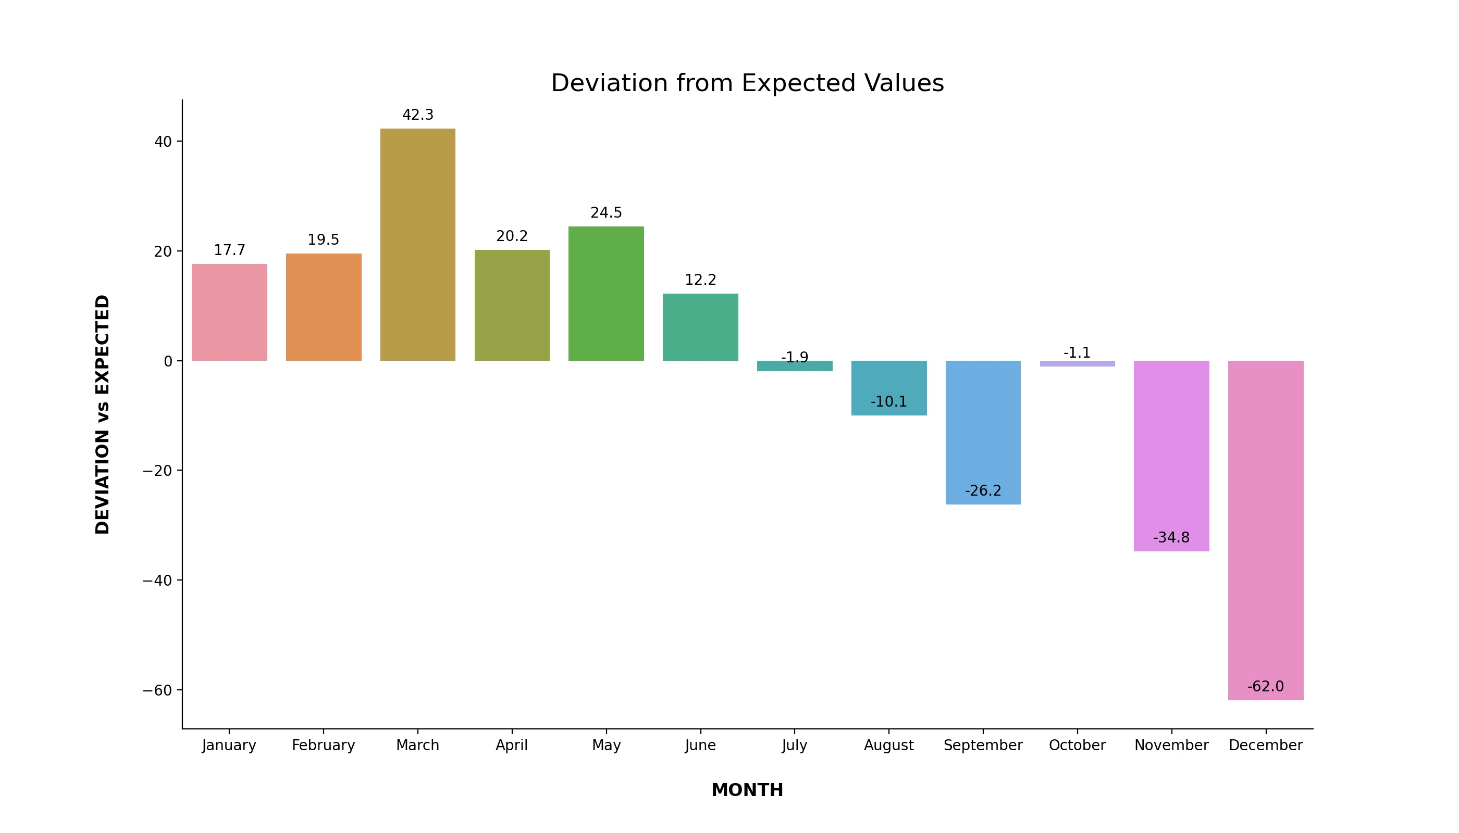
Total anual deviation was 272.28

Slide 10
CONCLUSIONS
More chances to get a low number at the end of the year than at the beginning.
All numbers below 195 were recruited. That means that you were more likely to go to war if you were born in the second half of the year than in the first half.
Is there a correlation or not between the month and the lottery number?
LINEAR REGRESSION
model = linear_model.LinearRegression()
y = months_69['Average lottery number']
X = months_69[['Mo']]

Slide 11
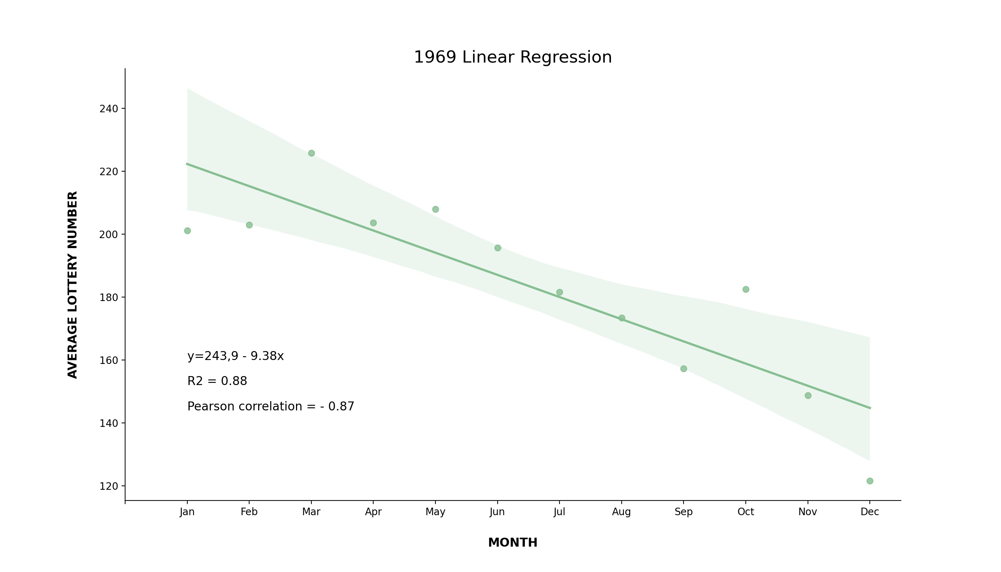
This correlation reveals a pattern: an absence of the uniformity by months

Slide 12
How improbable was the outcome of the 1969 lottery?
To check this, I generated 10000 drafts: 10000 different random ways of mixing the lottery box
--> Montecarlo Simulation.
Analysing the annual deviation of 10000 drafts, in how many of them would the result have been the same or more unbalanced?
How unlikely was the outcome if it had been "random"?

Slide 13
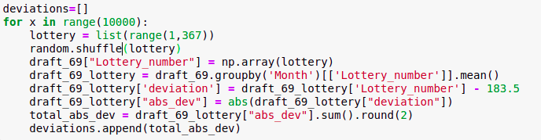
For each simulated draft:
1. Generate a list in random order from 1 to 366 (lottery number)
2. Calculate the average number of lottery in each month
3. Measure the deviation from the expected lottery number (183.5)
4. Add these month deviations and obtain the total annual deviation (in 1969 was 272)

Slide 14
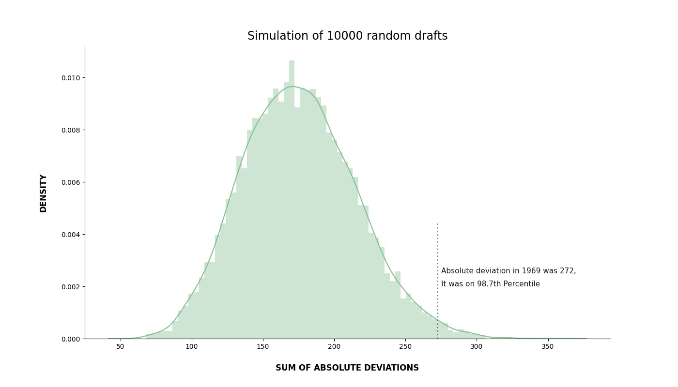
Only 137 of 10.000 had a larger deviation than in the 1969 draw.

Slide 15
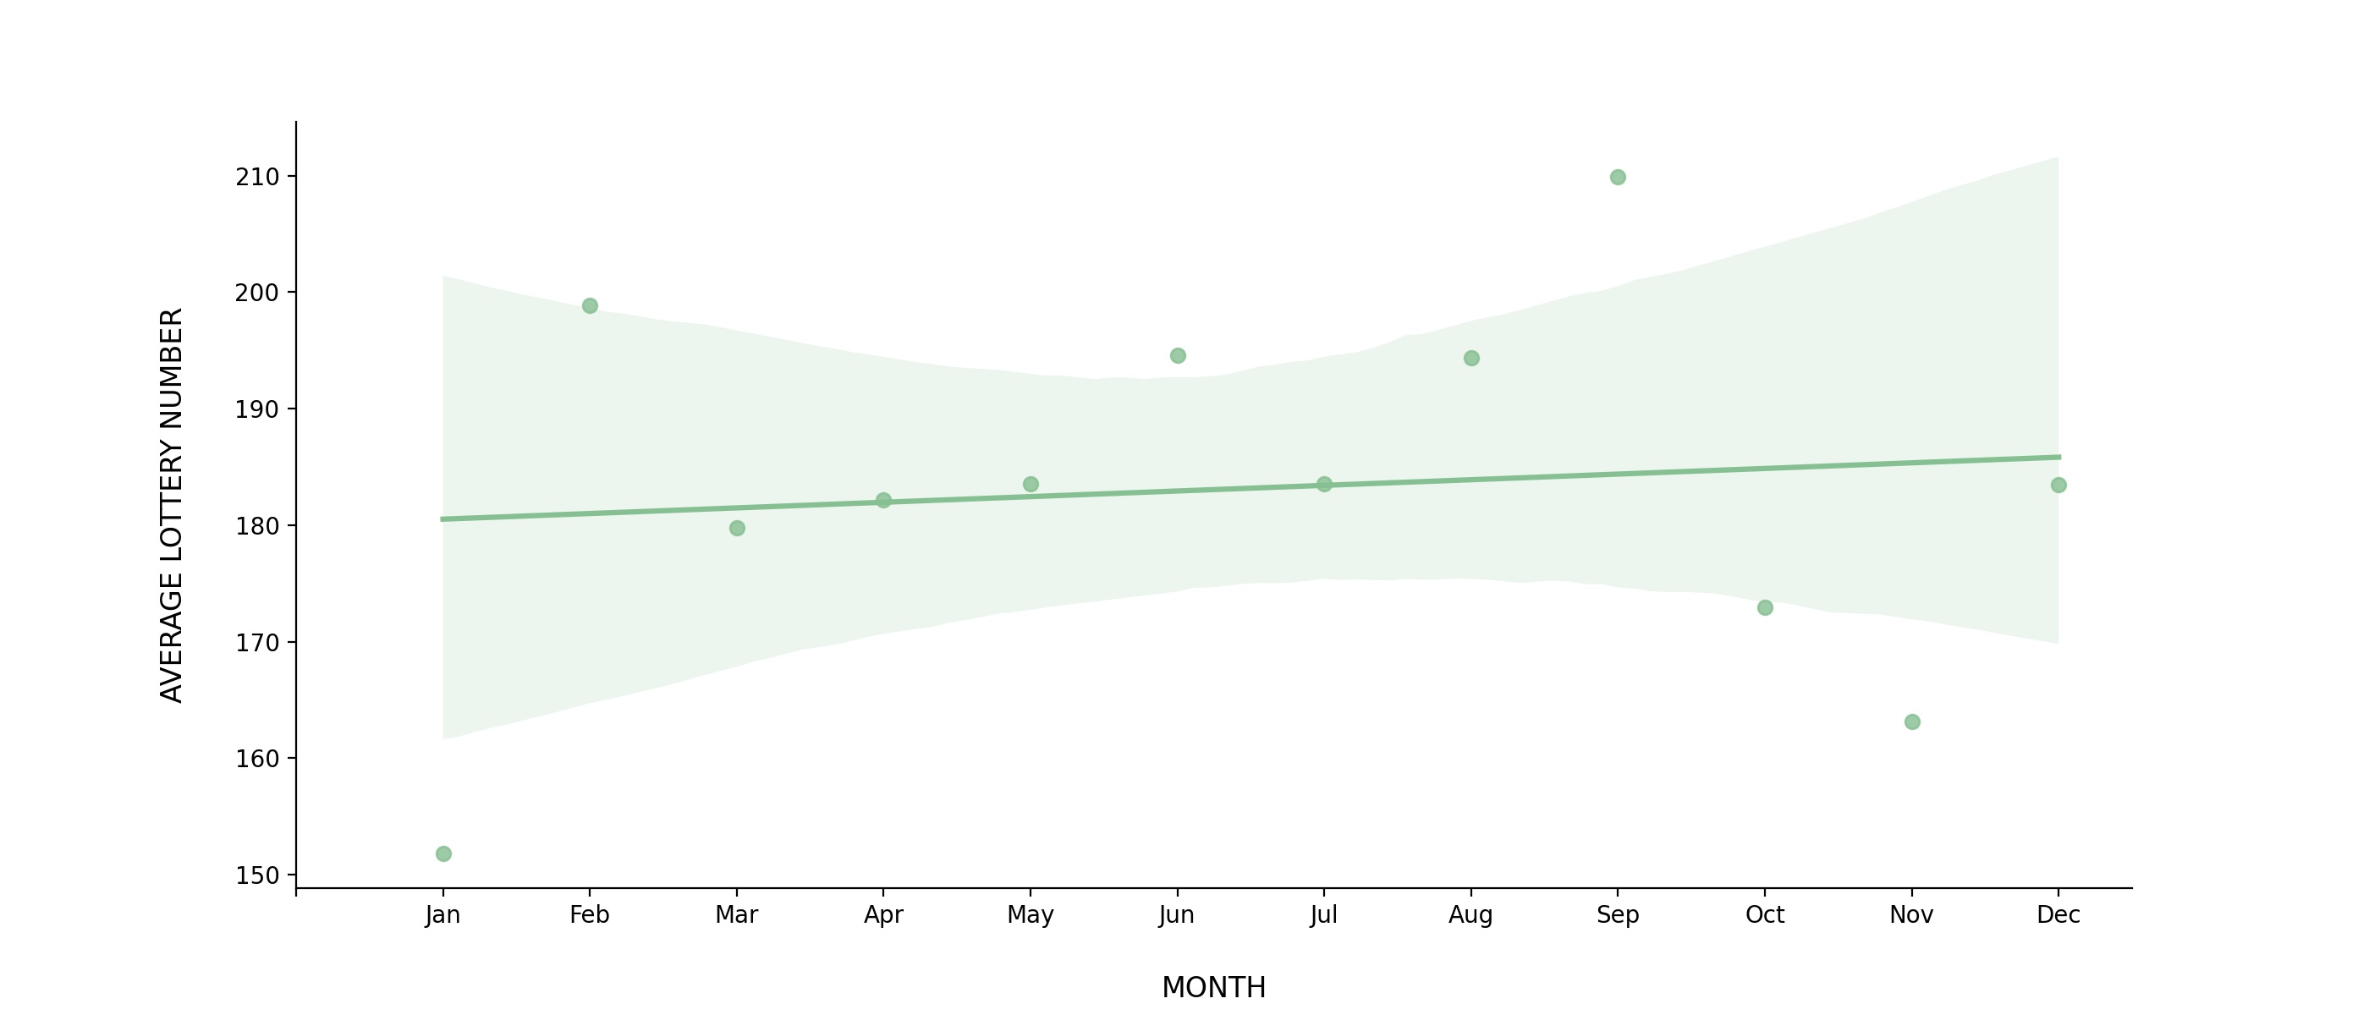
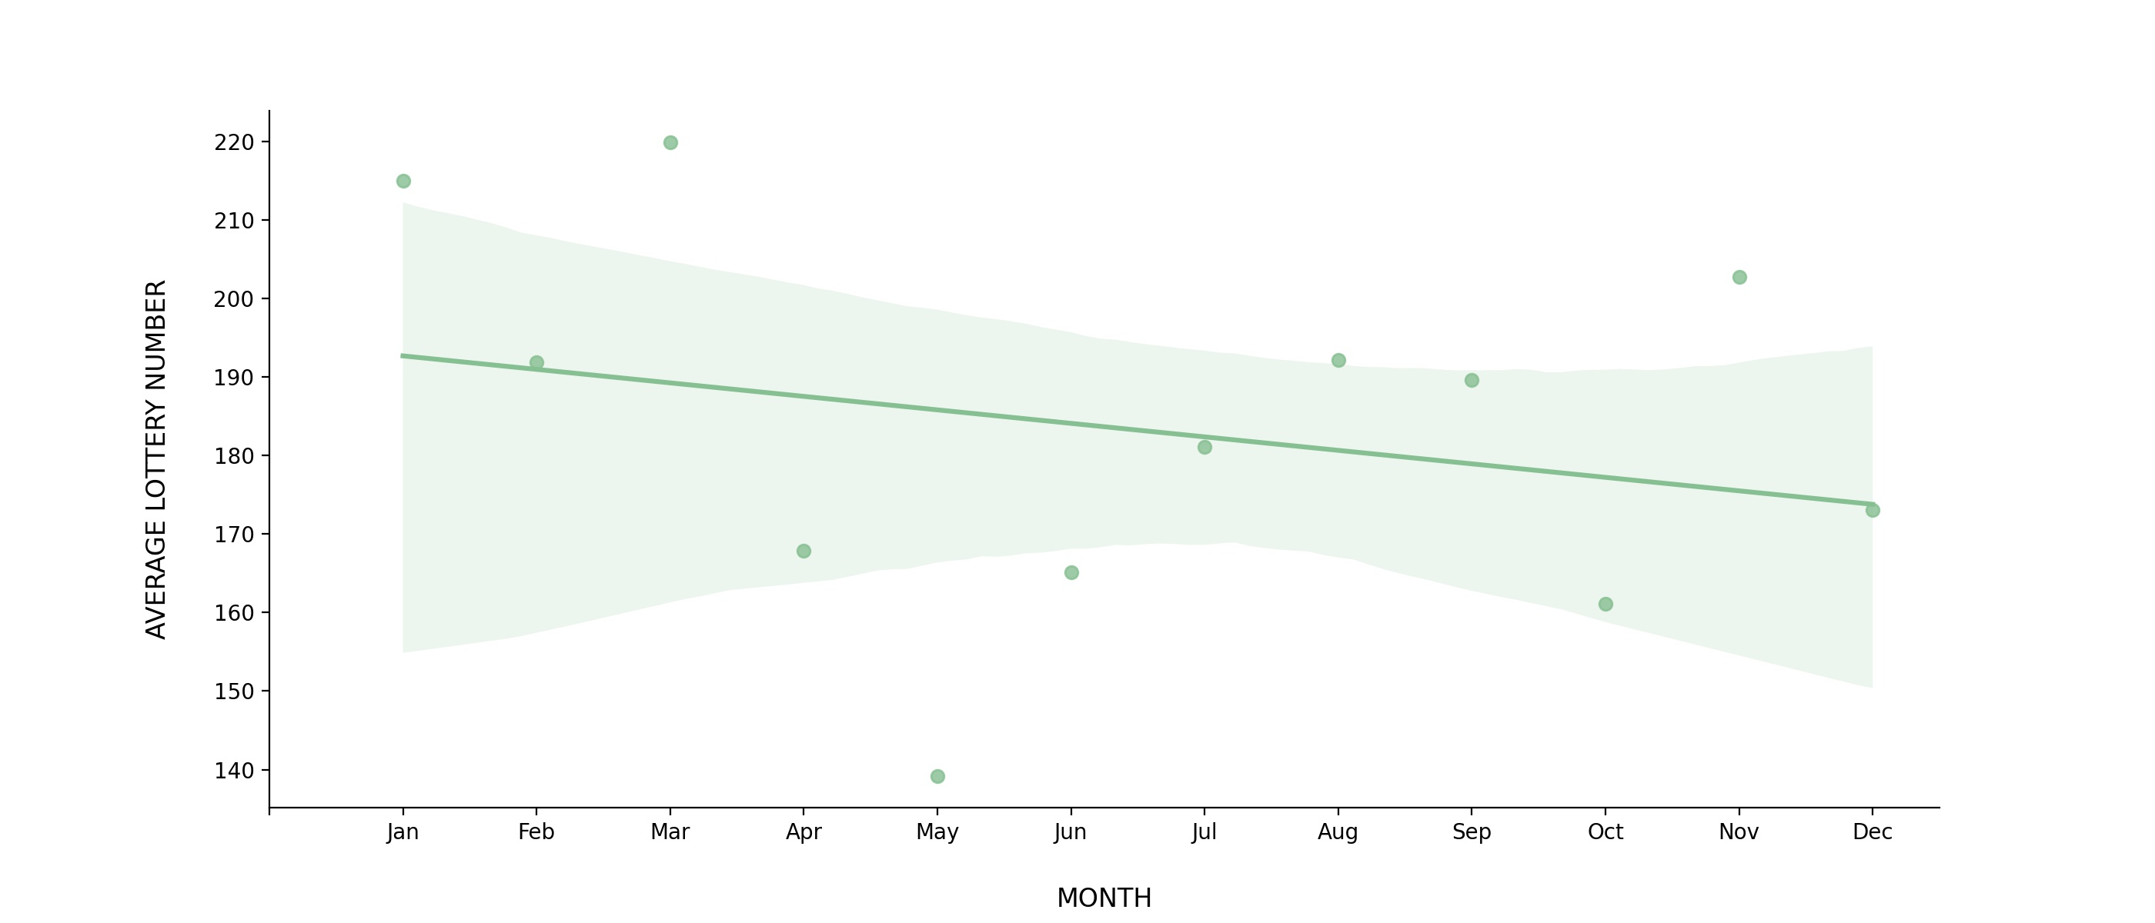
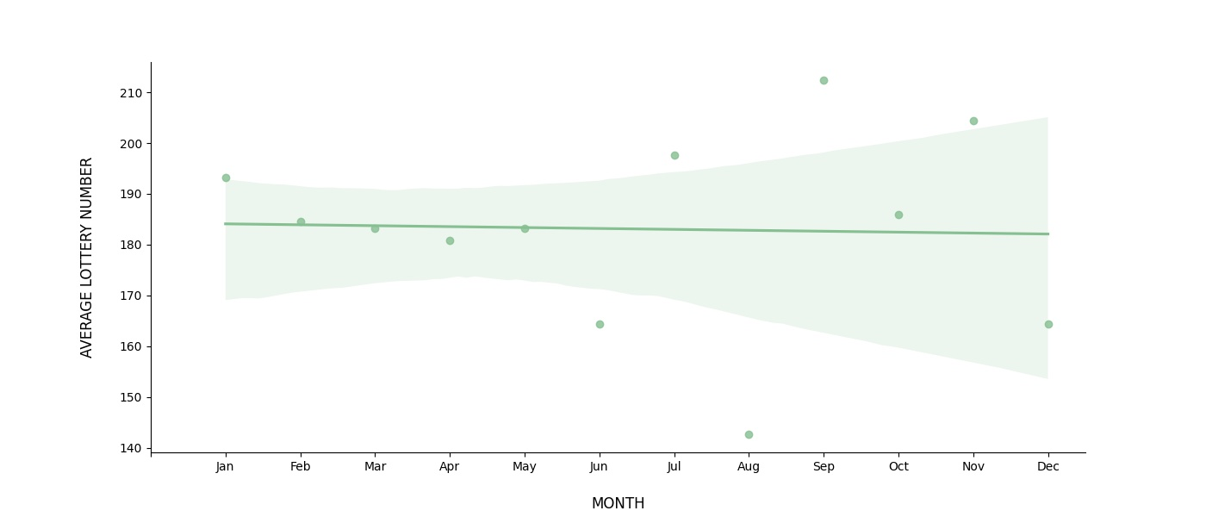
1970
How was the draft for the following years?
There is hardly any correlation
1971
1972

Slide 16
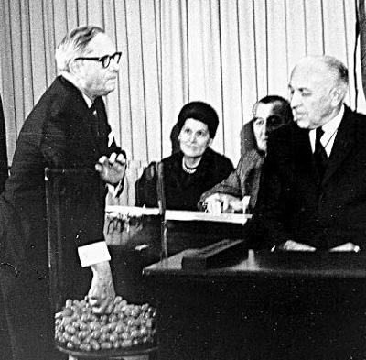
So, what went wrong with 1969 draft?
The answer is simpler than it seems...
texto

Slide 17


